Slide 1
Screen design and transition requirements
Ryo Fukano, Ph.D.
Business Innovation Department
ICT Solution Division
Komatsu Ltd.

Slide 2
Desktop screen 1: Portal
Cite Use Case 3
Filter | Condition
Time | 2013/7/1 to 2016/7/1
Velocity | 50km/h to 60km/h
Model | 930E, 860E
Affiliation | Mountain A, Mountain C
Event | Event A occurred three time for 10 hours
Target area
Cite Use Case 3
Clear condition
Add filter condition
Transition button 4
Unit | Model | Notification | Analysis
C1010 | 930E |  | Analysis 1: Good Analysis 2 : Status 90 Analysis 3: Good
C5326 | 930E |  | Analysis 1: Bad Analysis 2 : Status 96 Analysis 3: Good
C9362 | 860E |  | Analysis 1: Bad Analysis 2 : Status 30 Analysis 3: Bad
C4725 | PC3000
Clear area
!
9
?
3
This table indicates selected items in the above filters and map
!
2
?
2
Each row is selectable
User can select multi rows
?
1
Cite Use Case 1
Go to analysis
Go to maintenance record
Go to graph
Transition button 1
Transition button 2
Transition button 3

Slide 3
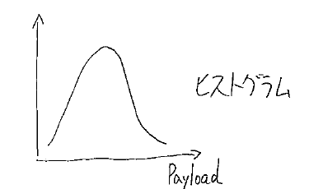
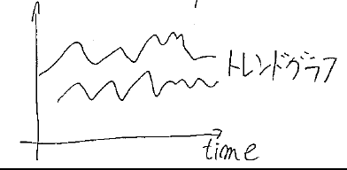
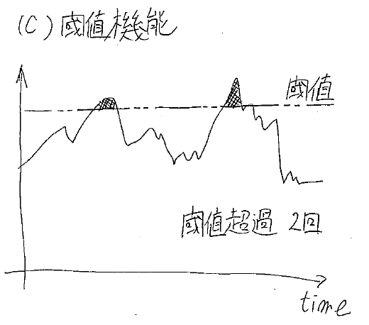
Desktop screen 2: Graph
Notes: this screen 2 inherits filter condition of screen 1
C1010, C5326
Target machines selected screen 1
Cite Use Case 2
Cite Use Case 2
histogram
Trend graph
User select menu
User can input text directly
Auto completion text field
Target sensor: sensor 1
Target sensor: sensor 3
Each row is selectable
User can select multi rows
selected item is highlighted
Cite Use Case 2
Event Tabulation
Threshold analysis
Name | Count
Event A | 35
Event B | 63
Event C | 26
Event D | 19
Threshold
User configurable
Cite Use Case 2
Threshold count: 2 times
Clear tabulation
Add event
Go to event history
Target sensor: sensor 2
Transition button 2
Transition button 1

Slide 4
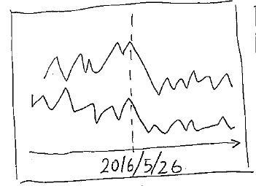
Desktop screen 3: Event history
Notes: this screen 3 inherits filter condition of screen 1
C1010, C5326
Target machines selected screen 1
Event A
Event Tabulation
Event A
Name | Count
Event A | 35
Event B | 63
This table inherits select items in screen 2
Event A
Event B
Cite Use Case 4
Event history
Event mapping
Date | Unit | Event
2016/7/1 | C1010 | Event A
2016/5/26 | C5326 | Event A
2016/5/15 | C1010 | Event B
2016/4/3 | C1010 | Event A
2015/12/31 | C5326 | Event A
2015/11/30 | C1010 | Event B
2016/5/26 | C5326 | Event A
This graph indicates “Event history” selected items
Each row is selectable
User can select multi rows
selected item is highlighted
Target sensor: sensor 2
Add sensor
Target sensor: sensor 1
Transition button 1

Slide 5
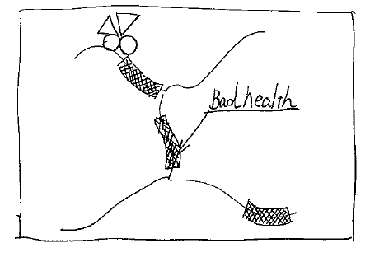
Desktop screen 4: Analysis
Notes: this screen 4 inherits filter condition of screen 1
C1010, C5326
Target machines selected screen 1
Cite Use Case 5
Trend graph
Analysis status is projected on a map
Target: analysis 3
Threshold analysis
Threshold
histogram
Threshold count: 2 times
Target: analysis 2
Target: analysis 1
Transition button 1

Slide 6
Desktop screen 5: Maintenance record
Notes: this screen 5 inherits filter condition of screen 1
Target machines selected screen 1
C1010, C5326
Cite Use Case 5
Each row is selectable
User can select multi rows
Maintenance record
Filter condition of maintenance record
Additional filter condition for this screen
User can narrow target data
Date | Unit | Record
2016/7/1 | C1010 | Part exchange
2016/5/26 | C5326 | Part exchange
2016/4/3 | C1010 | Oil change
2015/12/31 | C5326 | Adjust pressure
Filter | Condition
Model | 930E
Affiliation | Mountain A
This selection relates to “Event history”
Clear condition
Add filter condition
Same function of screen 3
Event history
2016/5/26 | C5326 | Event A
Date | Unit | Event
2016/5/26 | C5326 | Event A
Target sensor: sensor 2
Add sensor
Target sensor: sensor 1
Transition button 1

Slide 7
Desktop screen 6: Individual history
C1010
Target machines selected screen 1
Trend graph
Unit | Model | Notification | Analysis
C1010 | 930E |  | Analysis 1: Good Analysis 2 : Status 90 Analysis 3: Good
!
9
?
3
Target: analysis 3
Maintenance record
Date | Record
2016/7/1 | Part exchange
2016/4/3 | Oil change
histogram
Target: analysis 2
Notification history
Date | Notification | Detail | Manual
2016/7/1 | Error
2016/7/1 | Warning
2016/6/26 | Warning
2016/5/5 | Error
2016/5/5 | Warning
2016/4/2 | Error
2015/12/31 | Error
Transition button 1

Slide 8
Desktop screen transition
Screen 2
Graph
Screen 3
Event history
Button 1
Button 1
Button 3
Screen 5
Maintenance record
Button 2
Screen 1
Portal
Button 1
Button 4
Button 1
Screen 6
Individual history
Button 1
Button 1
Screen 4
Analysis

Slide 9
Mobile screen 1: Portal
Cite Use Case 1
Preset machines
Transition button 4
Unit | Model | Notification | Analysis
C1010 | 930E |  | Analysis 1: Good Analysis 2 : Status 90 Analysis 3: Good
C5326 | 930E |  | Analysis 1: Bad Analysis 2 : Status 96 Analysis 3: Good
C9362 | 860E |  | Analysis 1: Bad Analysis 2 : Status 30 Analysis 3: Bad
C4725 | PC3000
Target area
!
9
?
3
!
2
?
2
User position
?
1
Go to analysis
Go to maintenance record
Go to graph

Slide 10
Mobile screen 2: Individual history
C1010
Target machines selected screen 1
Unit | Model | Notification | Analysis
C1010 | 930E |  | Analysis 1: Good Analysis 2 : Status 90 Analysis 3: Good
!
9
?
3
Notification history
Date | Notification | Detail | Manual
2016/7/1 | Error | Pressure A over
2016/7/1 | Warning | Pressure C high
2016/6/26 | Warning | Pressure A high
2016/5/5 | Error | Temperature B over
2016/5/5 | Warning | Temperature B high
2016/4/2 | Error | Pressure C over
2015/12/31 | Error | Pressure C over
Transition button 1

Slide 11
Mobile screen transition
Screen 1
Portal
Button 4
Screen 6
Individual history
Button 1

